Slide 1


A seminar presentation on
Cointrix: A Blockchain based cryptocurrency
Walletio: A cointrix based e-wallet
By- Guide
Pranav Kiran Waikar Mr. Sudam Pawar
Pratik Deshmukh
Rohan patil
Aditi kulkarni
Department of Computer Engineering
STES’s Sinhgad Institute of Technology and Science, Narhe, Pune

Slide 2
Today’s discussion aims …
—Introduction
—Motivation
—Challenging Issues
—Literature Survey
—Statement of Aims and Objectives
—Proposed Architecture
__Gap analysis
—Conclusions
—References

Slide 3
Introduction
If we take a look around us, we are surrounded by Block Chains.
Unlike regular currencies, crypto currencies are secure, trusted and have a decentralized autonomous ecosystem.
The distributed ledger technology provides solid base for our autonomous system.
Block chain based crypto currency has been approved in Dubai to be used as a valid currency and using crypto currrency for its daily transactions.

Slide 4
Motivation
The block chain systems have ability to operate independently without any central management.
Systems like bit coin successfully bypassed central banking system.
Systems are open, safe, easy, fast and cheap.
The big players are now interested in using block chain
i.e. Microsoft Azure, Apache open chain.
Block chain based crypto currency is still in its budding state and has a lot of scope for development.

Slide 5
Challenging Issues
Accessibility:- Once the private access keys are lost, they cannot be recovered since they are unique and cannot be regenerated.
Legality:- Block chain based crypto currencies are seen as black market entities and are not yet seen as a legal form of currency.
No regulatory authority:- As these systems are not owned by any authority, the stake holders of the system suffers the loss.

Slide 6
Paper-I
Y. Yuan, S. Member, and F. Wang, “Blockchain and Cryptocurrencies : Model, Techniques,and Applications,” IEEE Trans. Syst. Man, Cybern. Syst., vol. PP, pp. 1–8, 2018.

Slide 7
Literature Survey
What is block chain?
Open decentralised database of every transaction involving value & stored as immutable and unchangeable records.

Slide 8
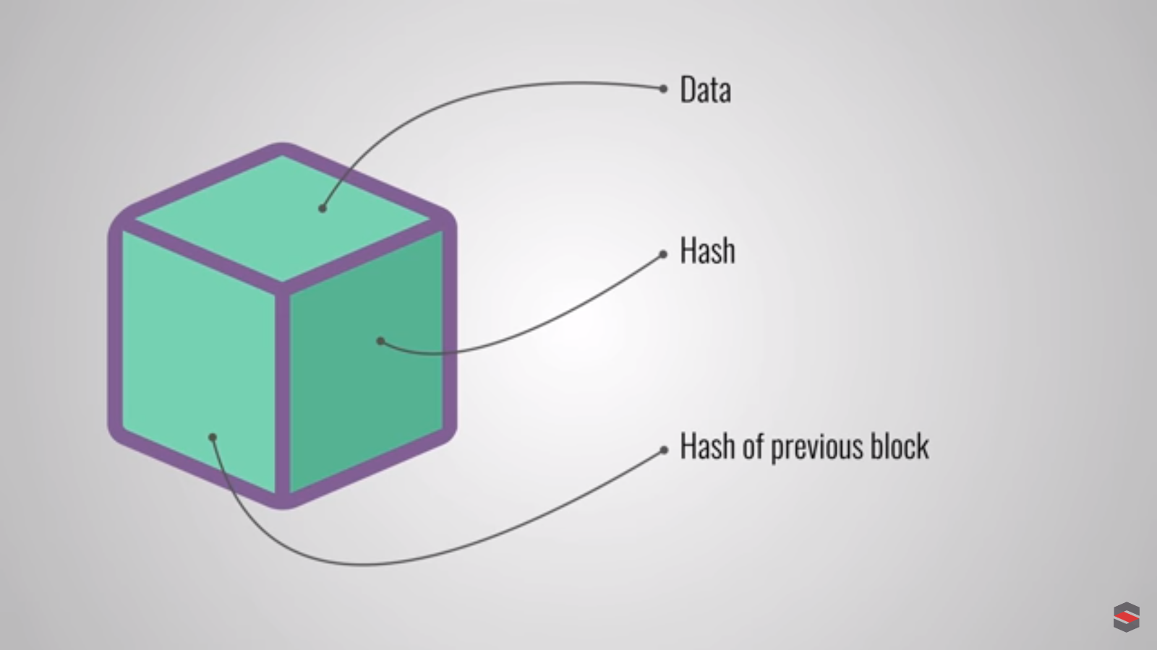
Literature Survey
Bitcoin: A Peer-to-Peer Electronic Cash System
What is a block?

Slide 9
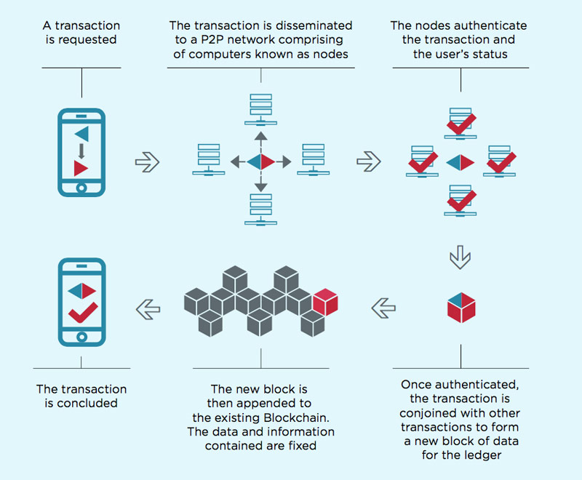
Literature Survey
How block chain works?

Slide 10
Literature Survey
Who will verify- Miners
Why someone will verify?-availing digital reward.
Why block chain?
1) No central trusted authority
2) Anonymity
3) Users are the infrastructure for system
4) No liabilities

Slide 11
Paper-II
X. Li, P. Jiang, T. Chen, X. Luo, and Q. Wen, “A survey on the security of blockchain systems,” Futur. Gener. Comput. Syst., 2017.

Slide 12
Literature Survey
Consensus protocol:-
Block chains set of rules.
All the nodes verify integrity of data.
Upon majority consent decision is taken.

Slide 13
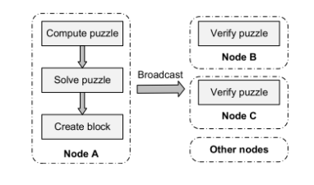
Literature Survey
Proof of work: To add a block-
Advantage:- Easy to apply
Disadvantage:- As system grows mining consumes more resources

Slide 14
Literature Survey
Proof of Authority:
It does not depend on nodes solving arbitrarily difficult mathematical problems, but instead uses a set of “authorities” - nodes that are explicitly allowed to create new blocks and secure the blockchain.
Advantage:- Secure, Reliable, liability
Disadvantage:- block chain has authority & not owned by public.

Slide 15
Paper-III
S. Nakamoto, “Bitcoin: A Peer-to-Peer Electronic Cash System,” Www.Bitcoin.Org, p. 9,2008.

Slide 16
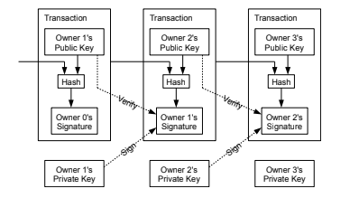
Literature Survey
Transaction Verification:

Slide 17
Literature Survey
Network :
1) New transactions are broadcast to all nodes.
2) Each node collects new transactions into a block.
3) Each node works on finding a difficult proof-of-work for its block.
4) When a node finds a consensus solution , it broadcasts the block to all nodes.
5) Nodes accept the block only if all transactions in it are valid and not already spent.
6) Nodes express their acceptance of the block by working on creating the next block in the chain, using the hash of the accepted block as the previous hash.
7) Nodes always consider the longest chain to be the correct one and valid in case of a tie.

Slide 18
Sr no | Paper title/idea | General idea of paper | Advantage & Limitation
1 | Blockchain and Cryptocurrencies: Model, Techniques, and Applications [2018] | A survey of current crypto currencies to understand block chain & its different types. | Advantages: Provides different incentive models , ecosystem & applications of block chain. Explains block chain in layered architecture. Limitations: Does not provide any solid architecture for its stated application.
2 | A Brief Survey of Cryptocurrency Systems[2017] | It evaluates the strengths, weaknesses, and possible threats to all major mining strategy. It outlines how Crypto currencies mine, where they have comparable performance and assurance, and where they have unique threats and strengths. | Advantages: 1. Currently, major Crypto currencies use Proof of Work, Proof of Stake or a combination of the both for mining. 2.A combination of the both is found to be effective. 3.Typically memory-intensive hash functions have been found to be faster mining algorithms. Limitations: A majority of hash algorithms are CPU-intensive and the others are memory intensive. 2.While Proof of Work is resource intensive, Proof of Stake cannot act independently. 3. Crypto currencies are still experimenting with their mining protocols and algorithms to optimize their performance. No full proof algorithm has been found yet.
3 | Blockchain: Future of Financial and Cyber Security[2016] | This paper explains the concept, characteristics, need of Blockchain and how Bitcoin works. It attempts to highlights role of Blockchain in shaping the future of banking, | Advantages: 1.Decrease in device cost 2.Increases computing power Limitations: 1.If any attack done by attacker then there will be loss of all bit coins,we cant recover it because government is not involved in .

Slide 19
Sr no | Paper title/idea | General idea of paper | Advantage & Limitation
4 | Bitcoin: A Peer-to-Peer Electronic Cash System[2008] | A distributed peer to peer system working under blockchain framework. | Advantages: Cryptocurrency without any central authority. Successful POW mechanism. Limitations: The cost of POW consensus protocol will keep increasing as more people join the network.
5 | Trust Your Wallet : a New Online Wallet Architecture for Bitcoin [2017] | It introduces a wallet which is highly secured by Multiple signature. | Advantages: The scalability of disaster recovery center Limitations: If we lost one of key then we are not able recover that key .
6 | A survey on the security of block chain systems [2017] | Detail survey of the security issues in current systems and existing solutions | Advantages: A careful comparison between bitcoin and ethereum. Different aspects of system vulnerability Limitations: Cryptocurrency will need more methods to achieve security and privacy.

Slide 20
Gap analysis
There is a need of currency with proof-of-authority but without central point of failure.
Generalized public block chain API.
A crypto with hybrid consensus protocol.
A secure and high availability e-wallet for easy to facilitate transactions.

Slide 21
Statement of Aims and Objectives
Aim:-
Create a de-centralized block chain based crypto currency and an e-wallet to access currency.
Objectives:-
Create a generalized block chain API.
Use the API create a new crypto currency model.
Implement a secure and high availability e-wallet for transactions.

Slide 22
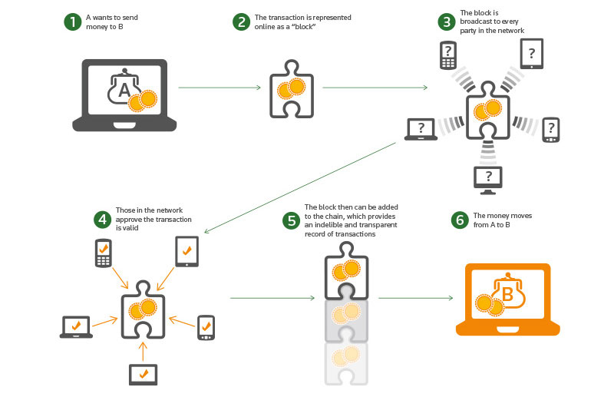
Proposed architecture

Slide 23
Advantages
No central point of failure unlike regular currency.
Full control over digital tokens by the owner.
Secure, available, fast, cheap and reliable.
Every transaction is verified by ever peer in the network.
Trust is in-built in the P2P system.

Slide 24
Conclusions
Thus we can see that there is a need of a de-centralized regulated transaction token(currency) without a central point of failure.
Also a generalized block chain API is needed which can further be used for purpose other than crypto currency.

Slide 25
References
References:
[1] Y. Yuan, S. Member, and F. Wang, “Blockchain and Cryptocurrencies : Model, Techniques,and Applications,” IEEE Trans. Syst. Man, Cybern. Syst., vol. PP, pp. 1–8, 2018.
[2] U. Mukhopadhyay, A. Skjellum, O. Hambolu, J. Oakley, L. Yu, and R. Brooks, “A Brief Survey of Cryptocurrency Systems.”
[3] S. Singh, “Blockchain : Future of Financial and Cyber Security,” pp. 463–467, 2016.
[4] S. Nakamoto, “Bitcoin: A Peer-to-Peer Electronic Cash System,” Www.Bitcoin.Org, p. 9,2008.
[5] F. Zhu et al., “Trust Your Wallet : a New Online Wallet Architecture for Bitcoin,” 2017.
[6] X. Li, P. Jiang, T. Chen, X. Luo, and Q. Wen, “A survey on the security of blockchain
systems,” Futur. Gener. Comput. Syst., 2017.

Slide 26
THANK YOU!
Thank you for listening!

